Slide 1


Session 3. Т24 Application Structure and Core Tables
Transact (T24) Functional Induction Training
Minsk, 2021

Slide 2




Agenda
Application Structure and Files in T24
T24 Workflow
User roles
Audit fields, record statuses, file suffixes
T24 Core Parameters and Core Tables

Slide 3
Agenda
Application Structure and Files in T24. T24 Workflow. User roles. Audit fields, record statuses, file suffixes.
T24 Core Parameters and Core Tables

Slide 4
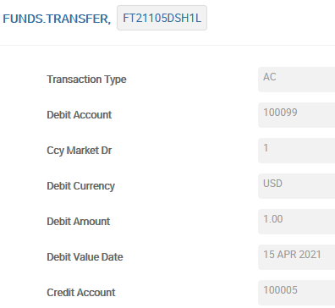

T24 Application
An application is a form which records the data entered and stores it in an associated file, field by field
What happens after we enter data?
FUNDS TRANSFER TABLE
@ID | Transaction Type | Debit Account | CCY Market Dr
FT21105DSH1L | AC | 100099 | 1

Slide 5
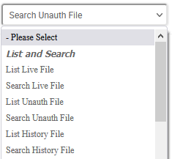
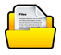
How is the data stored
Fields and field values are stored not just in one table, but 4 tables
Each form is associated with 4 tables («Files»)
Live
Unauthorized
History
Deleted

Slide 6


T24 Workflow
Banks usually use a 4-eye view for a financial transaction
To facilitate this – T24 has 2 stages in a transaction: Input and Authorisation
Unauthorized Record
Inputter
Live/Authorized Record
Authoriser
Notes:
1. A transaction in T24 can involve multiple stake holders. A transaction is input by a user and is authorized by his manager. Depending on the type and size of the transaction - banks might want more than 1 level of authorization.
To create a record in T24, you need to input all the mandatory fields and then get the record authorized.
1.1 Inputter is the person who inputs data into the fields in a record.
1.2 Authorizer is the person who checks the record and authorizes it.
2. The error message “EB.RTN.SAME.NAME.AUTHORISER/INPUTTER” will be displayed if the same user tries to input and also authorize the record.

Slide 7
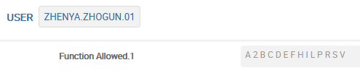
User Roles
User could make Input or Authorize functions only if he has appropriate privileges. It could be established via User Roles or directly in USER application:
A – Authorize
2 – 2nd Authorizer Permission
C – Copy
D – Delete
E – List exceptions (List unauthorized records)
H – History restore
I – Input
L – List live records
P – Print
R – Reverse
S – See
V – Verify
Q – Audit
Notes:
FUNCTION : List of valid functions that the user can use in the company. Type ALL to give access to all the functions. When the record is committed it will display the values A 2 B C D E F H I L P R S V automatically. The Q function does not appear by default. Q stands for Audit Review.
‘A’ is a function which allows the user to authorize a record.
For a User to authorize a record in INA2 Status, a value of 2 needs to be set in the FUNCTION field of their USER profile.
‘C’ is a function which allows the user to copy a record.
‘D’ is a function which allows the user to delete a record which is not yet authorized. A live record cannot be deleted.
‘E’ function allows the user to list the unauthorized records.
‘H’ function is used to move a record from history to live file.
‘I’ function allows the user to input a record in an application.
‘L’ function is used to list live records
‘P’ is used for printing
‘R’ is used to reverse a record which is no longer used.
‘S’ allows user to only view the records.
‘V’ is a special function which is supported only by some applications in T24. It is used to produce some extra information and also performs some extra actions. V function is known as verify function

Slide 8


Auditing information - Need for History File
Delete
Amend the record
History
Deleted
$NAU
$HIS
$DEL
Live
Unauthorized
Authorize
Notes:
Financial transactions , need version control
We need to store the changes made in every record
In T24, the current authorized version of a transaction is kept in the live file and older versions are maintained in a history file
The reason for having separate history files is that over a period - this information can be archived

Slide 9
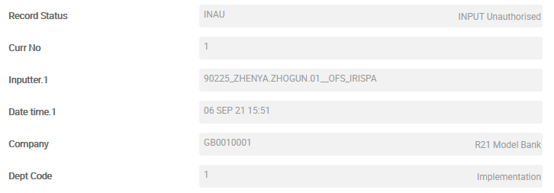
Audit Fields of an application
When a record is commited or authorised, T24 updates some fields called the “Audit” fields
They are auto stamped fields attached at the end of every record across applications
Present almost in all T24 applications
Notes:
When a record is commited or authorised, T24 updates the following audit fields. They are no input fields attached at the end of every record across applications.
RECORD STATUS: Holds the status of the record. Possible values are INAU, IHLD, INAO, etc.,. If the record is in live file, then there is no entry in this field.
CURR NO. : Holds the number of times the record was edited.
INPUTTER : Holds the ID of the user who has inputted the record.
DATE TIME : Holds the date and time when the record was last edited
AUTHORISER : Holds the ID of the user who has authorized the record.
CO CODE : Defaults based on current company logged into
DEPT CODE : Defaults to the user’s department code
The two fields below are populated only when a record is audited (Q function)
AUDITOR CODE : Holds the code of the auditor who has reviewed the record.
AUDIT DATE TIME : Holds the audit date and time.

Slide 10
Status of a Record
We know that a record passes through many stages – Unauthorized, Live, Authorized, History and many more
The status of a record is found using the field – RECORD.STATUS
For a live record, this field does not have a value
Live records cannot be deleted. They can be reversed
The possible statuses a record can have are:
INAU – Input Not Authorized
INAO – Input Not Authorized due to Overrides
INA2 – Input requires Second Authorizer
RNAU – Reversal Not Authorized
RNA2 – Reversal requires second Authorizer
RNAO – Reversal Not Authorized due to Overrides
HNAU – History Restore Not Authorized
IHLD – Input on HOLD
REVE - Reversed
Notes:
When a record is commited or authorised, T24 updates the following audit fields. They are no input fields attached at the end of every record across applications.
RECORD STATUS: Holds the status of the record. Possible values are INAU, IHLD, INAO, etc.,. If the record is in live file, then there is no entry in this field.
CURR NO. : Holds the number of times the record was edited.
INPUTTER : Holds the ID of the user who has inputted the record.
DATE TIME : Holds the date and time when the record was last edited
AUTHORISER : Holds the ID of the user who has authorized the record.
CO CODE : Defaults based on current company logged into
DEPT CODE : Defaults to the user’s department code
The two fields below are populated only when a record is audited (Q function)
AUDITOR CODE : Holds the code of the auditor who has reviewed the record.
AUDIT DATE TIME : Holds the audit date and time.

Slide 11
File Suffixes in T24
File Type | Purpose | Naming Convention | Record Status possible
Live File | Holds only authorized records | <ApplicationName> | Blank
Unauthorised File | Holds all the unauthorized records | <ApplicationName>$NAU | INAU, INAO, INA2, RNAU, RNA2, RNAO, HNAU, IHLD
History File | Holds old copies of modified authorized records | <ApplicationName>$HIS | REVE
Deleted | Holds deleted unauthorized records | <ApplicationName>$DEL | INAU, INAO, INA2, RNAU, RNA2, RNAO, HNAU, IHLD
Notes:
Data which is entered into T24 applications are stored in Files at database level.
1. At database level these files are broadly classified into three different categories. They are Live files, Unauthorized files and History files.
1.1 Live files store only authorized records. There will be no Record Status for records in Live files.
1.2 Unauthorized files ($NAU) store unauthorized records. There are various Record Statuses that can be associated with records in Unauthorized Files. The Record Statuses are: INAU, INAO, INA2, RNAU, RNA2, RNAO, HNAU, IHLD
1.3 History files ($HIS) store old copies of authorized records. When an authorized record is edited and the changes authorized, the latest version of the record is stored in the Live file and the old version is moved to the History file. If an authorized record is reversed and the reversal authorized, that record too moves from the Live file to the History file. The Record Status of a reversed record is REVE.
Format of the record ID is : <Record ID>;<Sequence Number>
For Example : 100297;4
100724;3
The History file can store any number of amendments of a particular record.
2. Applications that have a financial impact have all the three types of files.
Most of the T24 applications have all the 3 types of files at database level.

Slide 12
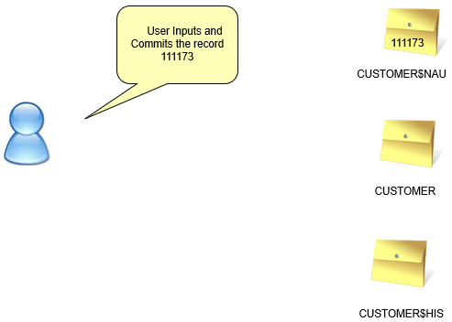
File Suffixes – The journey of a T24 record
Notes:
T24 application records might have different status at different points in their life cycle. For this purpose, T24 applications have multiple files at database level to store these records based on their statuses.
When you input and commit a record in the CUSTOMER application, the record is stored in the unauthorized file CUSTOMER$NAU.

Slide 13
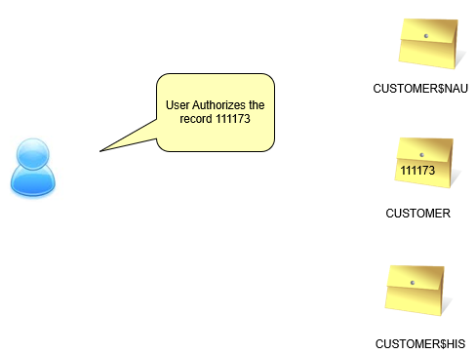
File Suffixes
Notes:
When a CUSTOMER record in INAU status is authorized, the record is deleted from CUSTOMER$NAU the unauthorized file and written to the CUSTOMER Live file.

Slide 14
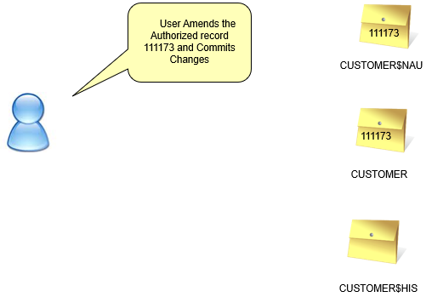
File Suffixes
Notes:
When you edit an existing authorized CUSTOMER record, this amended copy of the record is written to the unauthorized file CUSTOMER$NAU when committed. The authorized copy of this record still remains in the Live CUSTOMER file.
At this point in time it is important to understand that if you request for the record using the Input or Authorize function, T24 returns the record from the $NAU file. If you request for this record using the See function, T24 return the record from the Live CUSTOMER File.

Slide 15
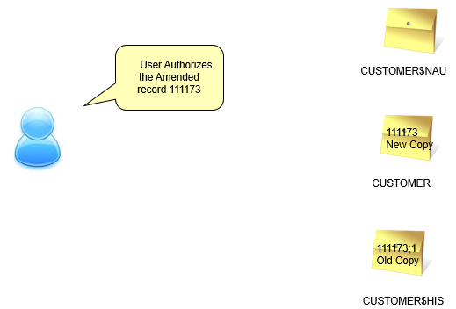
File Suffixes
Notes:
When you authorize the record currently in $NAU it is deleted from CUSTOMER$NAU and written to the Live CUSTOMER file. The previously authorized record will be moved to History that is the CUSTOMER$HIS file in order to keep a trail of all changes to the record.

Slide 16
Agenda
Application Structure and Files in T24. T24 Workflow. User roles. Audit fields, record statuses, file suffixes.
T24 Core Parameters and Core Tables

Slide 17
Core Parameters
Core Parameters in T24 are grouped in three types:
The Bank Parameters are required for the set up and the functioning of T24 in the Bank
The Finance parameters are required in order to run certain T24 applications and to monitor the Bank’s Financial Accounting
The Customer parameters are required to create and manage the customers of the bank using T24
Notes:
This is a conceptual classification to understand the different parameters required to run T24 Bank.
These parameters are spread in T24 menus and options according to the model bank structure.

Slide 18
Core Parameters
Bank Parameters
Finance parameters
Customer parameters
Notes:
This is a conceptual classification to understand the different parameters required to run T24 Bank.
These parameters are spread in T24 menus and options according to the model bank structure.

Slide 19
Bank Parameters
Bank profile: it holds information about the bank running T24
Country of operations: The Country where the T24 Bank is operating
Languages used: The main languages used by the bank to communicate with its customers
Weekends and Holidays of the Bank: the weekends and the non-working day of the bank
Back-value dates: The management of back-value transactions
Forward-value dates: The management of forward-value transactions
Notes:
These parameters are required by T24 in order to put the Bank in its operating environment.

Slide 20

The Where of the environment – COMPANY (Branch)
What?
Each branch is called a COMPANY in T24
Catalogued in COMPANY table
The ID of a record in the COMPANY table is the company code
Ex: GB0010001, EU0010001
T24 offers a multi-branch solution, i.e. one installation of T24 can support multiple branches
A user logs into a Branch
Why?
Notes:
—
COMPANY table holds one record per company created in the installation.
The company record will hold the mnemonic which is used as the database file prefix.
The ID of a record in the COMPANY table is referred to as the company code in T24. The format is CCGGGLLLL Where: CC is Country Code GGG is Company Group Code and LLLL is Local Code. For example GB-001-0001

Slide 21
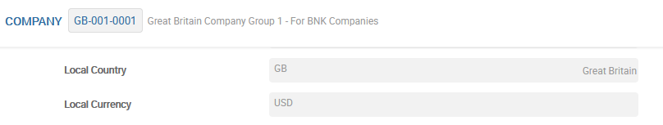
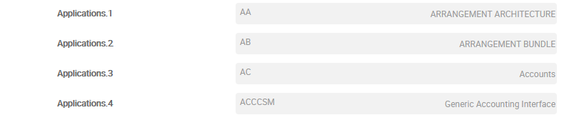
Branch settings
What are the other settings that can be done for a COMPANY (Branch)?
The Country, Region and the local Currency
Applications to be used
Financial Year End
Notes:
—
LOCAL COUNTRY : This field holds the country code where the company is situated.
LOCAL REGION : This field identifies the region in the country in which the company is physically situated.
LOCAL CURRENCY : This field holds the local currency of the company.
The Bank may restrict the access of applications to different companies. A company may access only a set of applications. The applications to be accessed by the company have to be set in the APPLICATIONS field. APPLICATIONS : This field holds the various applications that are installed in the company. Different companies of a bank may have different set of applications installed.
FINANCIAL YEAR END : This field holds the current financial year end date and the frequency from there on.
Sharing of files among different branches can also be set in COMPANY application

Slide 22
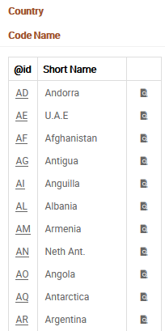
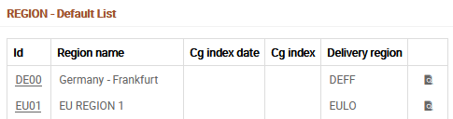
COUNTRY and REGION
In T24 we will set up a list of country codes. These country codes are useful for various purposes such as defining customer’s country of residence and nationality. Another objective is to enable the set up of holiday tables so as to check working and non-working days for system processing purposes
Besides countries we can optionally set up regions. One reason is because there could be specific regional holidays within a country
Notes:
The COUNTRY table contains static details of each individual Country such as the Country Name and the Currency Code.
Dummy Country codes may also be used for defining entities that do not have an official Country code but have a Currency Code, for example, EUROPE.
The REGION table is an optional table and is used to segregate a Region within a Country where the public holidays or non working days differ from other parts of the Country. This enables a separate HOLIDAY table to be defined for the Region.
In the screenshots here, you can observe that we have set up USA with a country code US. We can further define various regions for US. For example, US01 for New York and US02 for California etc.

Slide 23
DATES
What?
DATES table holds date information for the T24 system
Date information is held at a branch level
Stores the previous, the current and the next working day
Automatically rolled forward by the close of business services
T24 does not consider the system date because a single installation can run on multiple servers and each have potentially different dates
T24 being a banking software, revolves around amounts and dates. Dates are an important part of every financial transaction.
Why?
Notes:
T24 maintains and uses its own dates. DATES table is used to define the run dates for the previous, the current and the next working day.
2. T24 does not consider the system date but its own date from the DATES table.
3. The DATES table need not be manually updated to change the current working day. Dates are rolled forward automatically during the Close Of Business process.
4. All Companies defined in T24 will have a record in DATES table.
5. DATES is an INT type of file and therefore the file name at database level is F.DATES.
Holidays are stored in another table, which will be discussed as we proceed
However some applications consider the system date. For example, in the USER application START DATE PROFILE field takes into consideration the computer date and not T24 date.

Slide 24
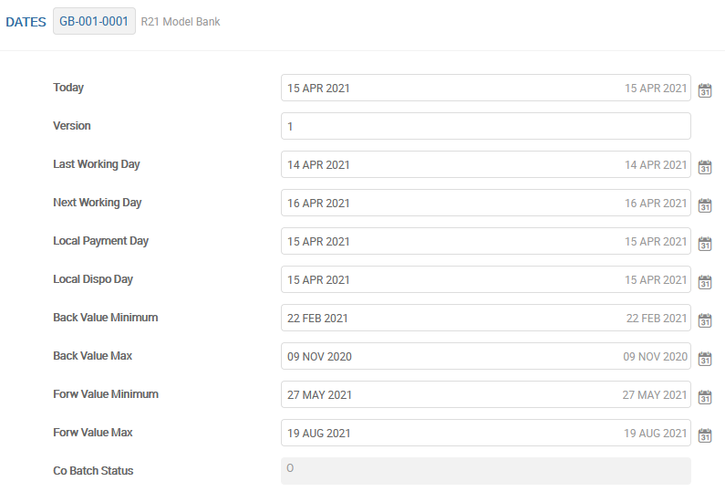
DATES
Notes:
The DATES table is used to store the previous, the current and the next working day. When the dates are rolled forward, only working days are considered.
The ID of a record in DATES table is the Company code.
TODAY : This field denotes the current T24 date.
LAST WORKING DAY : This field holds the date of the previous working day before COB was run.
NEXT WORKING DAY : This field holds the date of the next working day with respect to today.
The values in the above 3 fields will be updated during COB.
Values for these fields are populated during Close of Business after referring to the HOLIDAY table(To be discussed next).
Every transaction in T24 will contain a ‘Value Date’ which refers to the date on which the transaction will affect the banks books of accounts. Some T24 modules support a backward or a forward value date. The maximum back value and forward value possible is stored here.
BACK VALUE MINIMUM : This field specifies the minimum back value date for a transaction.
BACK VALUE MAXIMUM : This field specifies the maximum back value date.
FORWARD VALUE MINIMUM : This field specifies the minimum forward value date.
FORWARD VALUE MAXIMUM : This field specifies the maximum forward value date.
VERSION, LOCAL PAYMENT DAY and LOCAL DISPO DAY fields are reserved for future use and are not used currently.

Slide 25
HOLIDAY
What?
T24 uses the HOLIDAY table to indicate the public holidays and weekend days
This table is referred by the close of business service to roll the dates forward
The DATES table only stores information about dates
The HOLIDAY table drives the logic behind calculating date
Why?
Notes:
1. The purpose of the HOLIDAY table is to indicate the public holidays for each Country, or Region within a Country.
2. HOLIDAY is an INT type of file and therefore the file name at database level is F.HOLIDAY.
3. This table is referred during COB to determine T24’s next working day.
4. This table is also referred by T24 to check for holidays and weekend days when dates are input in any transaction.
5. The ID of a record in this table is in the format <CountryCode RegionCode Year>. For example GB 00 2010, AT 00 1988, etc..
Even before you set up a record in the HOLIDAY application, the REGION and COUNTRY tables must be set up since they are part of the record ID.

Slide 26
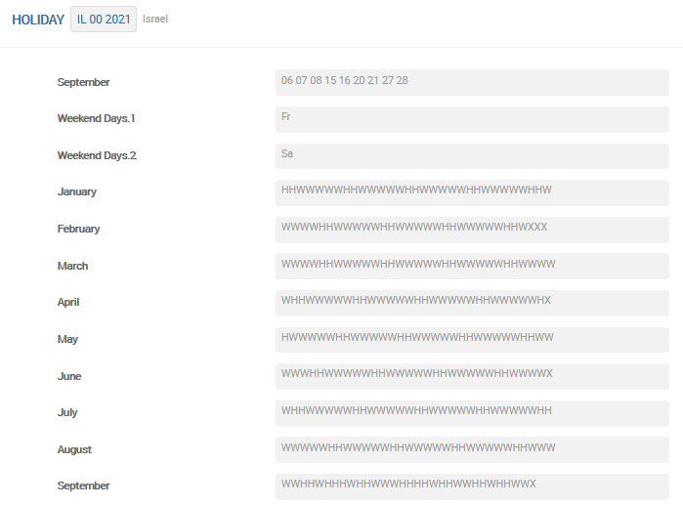
HOLIDAY
W = working day
H = non-working day
X = non-existent day, e.g. February 30th
Notes:
To set a particular day as a holiday in a month, the following fields are used
JANUARY – DECEMBER : These fields hold the days that need to be declared as holidays in the respective months. Valid values are 01 until 31 (if applicable). Space is the delimiter.
WEEKEND DAYS : This is a Multi value field that is used to define the days that are weekends. Valid input will be any of the days from Monday to Sunday
MTH 01 TABLE - MTH 12 TABLE : These fields are no input fields. These are populated based on values in fields JANUARY - DECEMBER, WEEKEND DAYS and WRK WKND JANUARY - WRK WEEKEND DECEMBER. This field can hold H W X as values. H stands for Holiday, W stands for Working day and X stands for No more days in the month.
WRK WKND JANUARY - WRK WEEKEND DECEMBER : These fields holds the days which are actually weekend days but to be declared as working days for each month. Valid values are 01 to 31 (if applicable)
It is not possible in T24 to declare Current day and the next day as holidays. T24 needs at least one day time to declare a working day as a holiday. For example, if today is 9th Jan and tomorrow is 10th Jan, you cannot set both 9th and 10th as holidays in T24. On 9th Jan you can only set 11th Jan and above days as holidays.
If there is any unforeseen situation and you have to declare a holiday during the middle of the day on 9th Jan, then the Administrator should run COB for 9th Jan before closing so that the dates are rolled over to 10th Jan which is the next working day.
If there is a situation that you have to set 10th Jan as a holiday on 9th Jan, then the Administrator has to run COB both for 9th Jan and 10th Jan so that the dates are rolled over to 11th Jan which is the next working day. Running COB back to back blindly may not solve this issue. Certain applications may require local development. If transactions come in through interfaces or ATMs on the physical 10th Jan, they will be taken as transactions for 11th Jan only as T24 date has already been rolled forward.
In typical situations, COB can also be run remotely by an Administrator.

Slide 27
Core Parameters
Bank Parameters
Finance parameters
Customer parameters
Notes:
This is a conceptual classification to understand the different parameters required to run T24 Bank.
These parameters are spread in T24 menus and options according to the model bank structure.

Slide 28
Finance Parameters
Currency parameters
Currency market
Currency rates
Interest rates types
Interest rates
Cost & Profit Centers etc.
Notes:
These parameters are required by T24 in order to put the Bank in its operating environment.

Slide 29
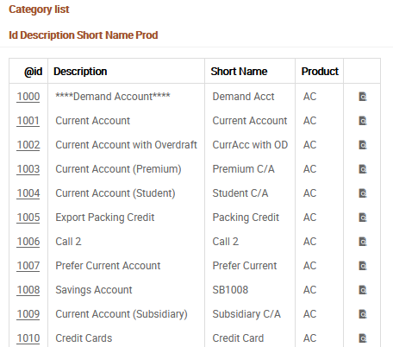
CATEGORY – Category codes
The category codes used to classify in T24 Financial Transactions and Products:
Products and Sub Products
Accounts
Profit & Loss
Notes:
The purpose of this section is to familiarize the Core consultant with the concept of Category, its importance and how it s used in T24.
The category codes are maintained by the Financial Accounting Consultant.

Slide 30
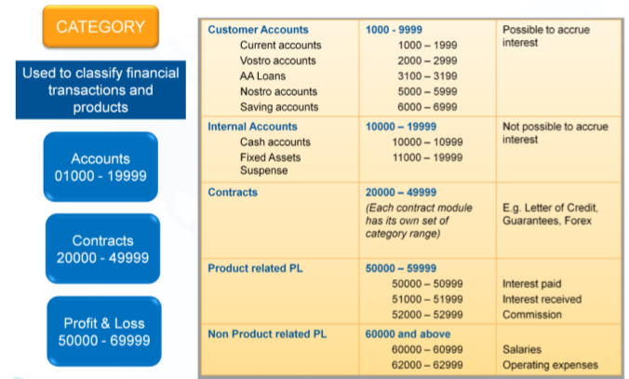
CATEGORY – Category codes
Notes:
Category codes are used to classify financial transactions on T24 according to the type of business operation or product. Category codes are also sometimes known as Product codes.
In T24, there are 3 broad key types of categories. They are: Accounts, Contracts and Profit & Loss. These broad category code ranges have been pre-defined.
The use of these codes, together with Customer characteristics, such as Residence, Status, Industry and Sector codes etc., can enable your organisation to produce balance sheets and other financial reports reflecting a coordinated and structured view of your operations.
Category Codes comprises up to 5 digits. The first or first two digits represent the highest level of classification and the remaining digits represent a subclassification which provides a clear definition of the product type or profit & loss.
These are just some of the Model Bank CATEGORY ranges shown here. You may refer to the CATEGORY table for the full list of category codes.

Slide 31
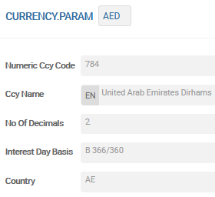
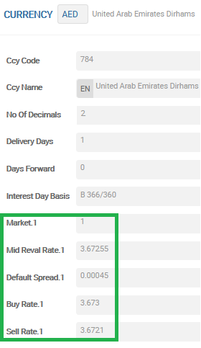
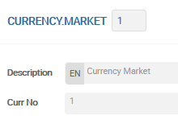
СURRENCY
CURRENCY
Gets actual rates for the currency defined. It can be entered manually or interfaced with external agents for regular feeds
CURRENCY.PARAM
Defines CCY Code
Main CCY settings
CURRENCY.MARKET
Possible to create different markets for the same currency
Notes:
T24 supports multiple currencies. All the supported currencies are defined in a table CURRENCY.
The associated currency tables are CURRENCY.PARAM, CURRENCY.MARKET and CURRENCY.
CURRENCY.PARAM is the parameter file and defines the numeric code and the decimal points for the currency.
CURRENCY.MARKET is used to create different forms of money available in the particular currency. Eg: cash, card, etc. The buy and sell rate for each currency market can be different and is defined in CURRENCY table

Slide 32
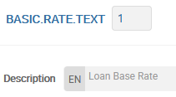
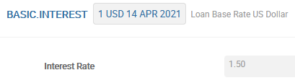
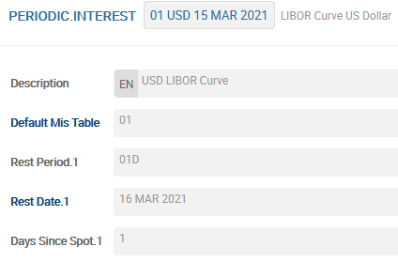
Interest Related Tables
In T24 there are various interest type options available to create a contract:
A contract can be manually input with a Fixed Rate
A contract can be created using a market floating rate which varies over time. One example is the Prime Rate. In T24 we call them Floating Rates (tables used: BASIC.RATE.TEXT and BASIC.INTEREST)
A contract can be created using time based interest rates. Such rates varies depending on the contract duration. One example is the LIBOR rate. In T24 we call them Periodic Rates (table used: PERIODIC.INTEREST)
Notes:
In T24, there are various interest type options available to create a contract

Slide 33
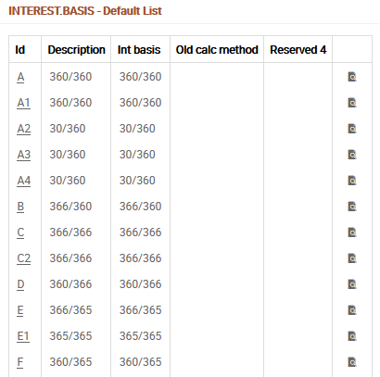
INTEREST.BASIS
Provides the basis of calculating interest
Notes:
In T24, there are various interest type options available to create a contract

Slide 34
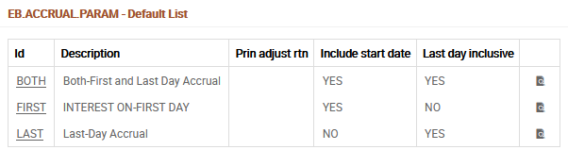
EB.ACCRUAL.PARAM
Determines if the interest accrual would include the Start date, the Last day or Both
Notes:
The accrual rule can be selected at the product level or can be made to be selected at the loan level. The screenshots here show the standard records from Model Bank. You may create new accrual rule records by defining appropriate field selections.

Slide 35
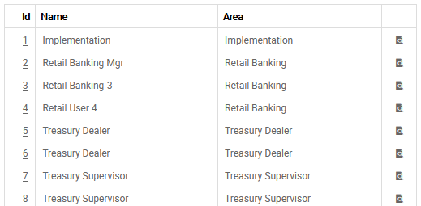
DEPT.ACCT.OFFICER
To define the list of Departments and/or Account Officers
An account officer or department code can be assigned to the contract
Such assignments can be useful for reporting and accounting purposes. It can also be relevant for some other purposes
Notes:
DEPT.ACCT.OFFICER is used to define the list of Departments and/or Account Officers

Slide 36
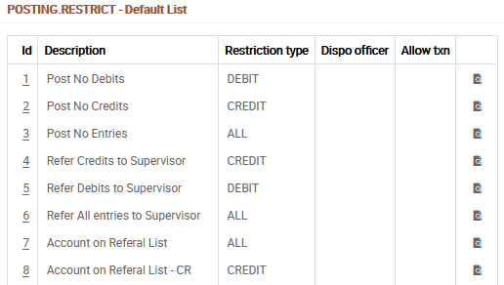
POSTING.RESTRICT
Posting Restriction codes are used to alert the user that restrictions apply when posting transactions
Posting restrictions can be applied on Customer and Accounts (including AA)
The selected posting restriction will appear as an override message at transaction level
Notes:
There are times when a Financial Institution would like to restrict debits and/or credits posted to an account. Posting Restrictions can be used for this purpose and can be useful for situations such as a bankruptcy or when a customer passes away. The POSTING.RESTRICT table displayed here demonstrates different reasons defined for not allowing transactions. Restrictions can be made as a full restriction or as a partial restriction. For example, we can define exceptions such as allowing the posting of bank charges while all other debit transactions will be restricted

Slide 37
Core Parameters
Bank Parameters
Finance parameters
Customer parameters
Notes:
This is a conceptual classification to understand the different parameters required to run T24 Bank.
These parameters are spread in T24 menus and options according to the model bank structure.

Slide 38
CUSTOMER
CUSTOMER application is central to organization of:
Information
Services
Profit and Loss
Customer records are opened and maintained for:
Clients: Private, Corporate
Agents: Other Banks, Brokers
Counterparties: Other Banks, Retail and Corporate
Notes:
Any business revolves around customer. T24 also is customer centric. Customer could be an individual, an organization, etc.
Customer is the centre of T24. Transactions can happen between banks, bank and customer, etc. Eg: Granting a loan or accepting a deposit is between a bank and a customer and a funds transfer may be between two customers.
Information regarding a customer is stored in the CUSTOMER table in T24. All the non-financial details like, address, signature, etc are stored.
Services offered to a customer can be account based or contract based. Account based services are like savings account, current accounts, etc. Contract Based services are granting loans, accepting deposits, mortgage, etc.
Any business derives profit from the services offered to a customer.
All the non-financial related information of a customer is stored in the customer record.
CUSTOMER application is central or “Core” to T24 system as all activities are customer centric in nature. All management information and services are organised around Customer record. Details mentioned in Customer records are not repealed anywhere else, but used by all applications. Any subsequent changes in these details are hence required to be done only at CUSTOMER application and hence it is easy to maintain. It contains all the basic information about any entity which the bank has dealings with. In T24, Customer record creation is not restricted to 'Bank's Customer' in the conventional sense of the word. A customer record will need to be opened for correspondent banks, brokers, guarantors etc., as well as for Bank's customers like current and savings account holders, borrowers, depositors and the like. Details in Customer record are descriptive in nature and not financial. For example, it holds the occupation, residence and contact details of a Customer. It will not hold the account numbers or balances in those accounts of a Customer.
All business process applications refer to the Customer record during processing. Therefore it must be opened before any Customer business activity. Customer records for Banks, Correspondent Banks and Agents should ideally be opened at the initial stage itself as this will help to minimise data input for settlement instructions in Money Market, Foreign Exchange and Funds Transfer applications.
Though some Banks insist that their Customers should always have an account with them before getting into any Contractual relationship, this is not mandatory universally. In Retail Banking, a private or corporate customer would normally have some kind of account such as savings account, current account or Overdrafts. Banks have Nostro
Account with other Banks. But a Customer need not be in account relationship with a Bank to do business. Contract type transactions such as FOREX, Money Market and Securities can still be arranged and a limit would normally be set up for a Customer for such dealings.
T24 distinguishes its business applications as Account based and Contract based. This comes from the underlying business of Banks which do allow balances in accounts to switch from positive to negative sign on the one hand and a loan remaining always a loan and a deposit always a deposit. Balances in these contracts never switch their accounting sign.

Slide 39
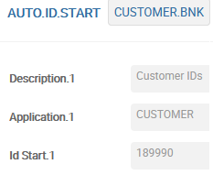
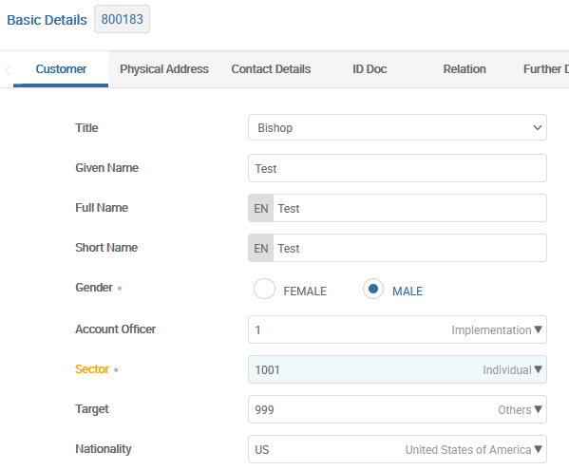
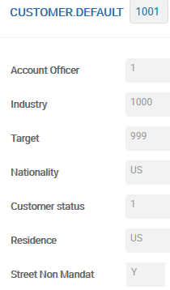
CUSTOMER
Notes:
Industry, Target, Nationality, Residence. Account officer and Customer Status of a Customer, depending on the value in this field. To achieve this, a record with the ID of Sector in usage should have been pre-defined in CUSTOMER.DEFAULT table. This facility will come in handy to quickly input Customer records of select Customers, who have more or less same values in one or more of these above aspects. The defaulted values
can also be selectively over written at individual record level. Useful only during initial creation and not during subsequent amendments.
Language for correspondence with the Customer can be chosen from any of the pre-defined languages set
in LANGUAGE static table. It may however be noted that T24 does not act automatically as a translating
software. Any text matter that requires to be translated should have been duly pre-defined for multi
language handling capacity.
Generally banks make it mandatory lo record Customer's mailing address. Hence, T24 also insists on providing proper address of a Customer. System maintains the address in STREET field as first print address of Customer in DE .ADDRESS. Additional mailing addresses can also be created through DE.ADDRESS. Email address, telephone numbers, fax numbers can also be mentioned in the appropriate field in the customer record. Some Banks would like to
maintain anonymity of Customer records. They would not like to record address of Customers nor send any mails. To make the address field as non-mandatory and purely optional
CUSTOMER.DEFAULT table could be used. For a chosen sector, a record can be created in this static table to indicate that while creating Customer records for people of this sector, we need not mandatorily record their mailing address.
Identification document details can be held for multiple identifications by using the multi value facility.
Passport, National Identification, if any can be mentioned here.
We can indicate how an existing Customer is related to the current Customer-who is related and how. By using the facility to multi value, we can also indicate multiple relationships. Our Customer is Father of another existing customer and employee of yet another existing customer. Such multiple relationships can also be captured.
All relationships that are required to be used are pre-defined in RELATION static table. We should also define reverse relationship code while defining the first relationship. For example Relation code of 1 is Father and reverse relationship of this is Child and its proposed code is 11. The System creates a record with ID 11 automatically in RELATION static table.
Role, the customer plays with this customer like authority to sign on behalf of the company, power of attorney etc., Data entered in this field must exist on the application EB.ROLE. There is another field called ROLE.MORE.INFO this field is mandatory if the ROLE selected has OTHER.INFO.REQ set to YES in the EB.ROLE table otherwise this
field may be left blank.

Slide 40
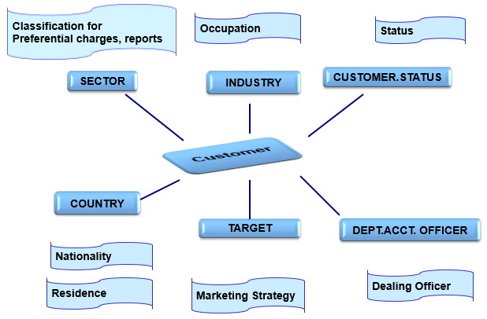
СUSTOMER - Associated Tables
Notes:
Customers can be classified based on a sector, industry, target, etc. The classification is for any preferential charges, marketing strategy to be used, etc. The status of the customer is used to define the net worth of a customer like high net worth client or a standard client, etc. It is also possible to assign a particular account officer who will manage the customer.
INDUSTRY table holds occupation related Information. Helps to identify the activity or business of Customer
is involved in.
CUSTOMER.STATUS table holds status related information like Large Corporate, Bankrupt Company and
Private Standard Client. Helps to identify the current status of Customer.
COUNTRY table holds name and important details of all countries. In a Customer record, these values are
used to indicate Nationality as well as Residence of Customers.
TARGET table defines classification of Customers from Bank's marketing strategy like High net worth and
Prime borrower. Useful for future marketing.
SECTOR table helps in defining grouping Customers at a top level for several purposes. This classification can be used for areas not covered by other classifications.
Sectors can be like Private sector. Public Sector, Infrastructure sector, Banks and IT sector. We shall be
seeing in later trainings the importance of Sector as it is used in ACCOUNT.CLASS and CUSTOMER.DEFAULT tables also.
All these classifications, besides holding information, can also be used to classify Customers for preferential treatments like interest conditions, tax rules and concessions in charges.
DEPT.ACCT.OFFICER table contains the Departmental hierarchy in a Bank. It can go down up to
naming all the Staff individually or stop at Department level. In a Customer record, the value indicates
the Relationship manager. Whenever there is a business dealing, then the Value from Customer record is defaulted, unless otherwise organised. This also appears in all accounting entries so that Departmental Assets and Liabilities or Profits could be measured.

Slide 41
Thank you for your time and attention!
FORANX LLC
Legal address:
35A, Ponomarenko str., 201 office, Minsk, 220015, Belarus
Tel.:+ 375 17 202 76 78
+ 375 17 202 76 79
Fax: + 375 17 362 34 22
Web-site: www.foranx.by
Minsk, 2021

